Slide 1



Department of Computer Science and Engineering
Virtual Mouse Controlled using eye gestures
Team Members Name / Register Number
Maria robin Andrew
211420104156
Balamani B
211420104033
Guide Name & Designation
Coordinator Name & Designation
Dr.Valarmathi.K M.E Ph.D.
Professor
Dr.Hemlatha Dhevi. A M.E. Ph.D.
Associate Professor

Slide 2
Introduction
Computers and technology have become integral parts of our day-to-day lives, constantly evolving and changing the way we live, work, and communicate with one another.
This project proposes an AI Virtual mouse which is controlled by the eye gestures to overcome the challenge of physical usage of the mouse. Eye gestures and face movements can be captured by a video capturing devices, which are used in human-computer interaction.
The design of the virtual mouse is made simple in terms of the interface and the interaction. The only extra hardware required is a video capturing device like a webcam.
The software is built using in python platform which is supported in all operating systems of the computer or can be installed.

Slide 3
Objective of the Project
The main objective of this project is to design a virtual mouse which should be useful for physically challenged people who cannot operated the mouse physically and should be able to operate using the eye gestures.
Can also used to overcome problems in the real world such as situations where there is no space to use a physical mouse and also for the persons who have problems in their hands and are not able to control a physical mouse.

Slide 4
Problem Statement
The usage of computers has been increased day to day, yet the physically disabled people find it near to impossible to use them. Controlling a mouse which is the simple GUI interaction can be tough job for the challenged persons.
To solve this issue, we propose a virtual controlled mouse which can help them to fill the gap. For those who find difficulty in touchscreens, voice dumb and physical mouse inaccessibility, this virtual mouse helps them to use mouse controls using eye gaze technique which makes mouse controls using eye movements.
Eye gaze technique which traces a human eye movements. Eye movements are one of the most reliable ones for the physically disables people which we can make use of. Eye movement are regarded as the inputs in many software for tracking to analysis purposes.
The eye gaze gets captured in real time frames from a web camera connected to the system without any other external hardware requirements.

Slide 5
Literature Survey
YEAR | TITLE | AUTHOR | WORK | DISADVANTAGE
2018 | Virtual Mouse Control by Webcam for the Disabled | Reyhan Seher Baştuğ; Bartu Yeşilkaya; Mazlum Unay ; Aydın Akan | A virtual mouse controlled by facial actions | Too much gestures for simple actions
2022 | Gesture Controlled Mouse Navigation : Hand Landmark Approach | Shaurya Guliani ; Renuka Nagpal; Rajni Sehgal; Abhishek Singhal | A virtual mouse controlled using hand landmarks | Controlled using hand movements which does not meet our problem statement
2022 | Face Direction Estimation based on Mediapipe Landmarks | Arqam M. Al-Nuimi; Ghassan J. Mohammed | Face detection and eye gestures tracking | Not used in virtual mouse control

Slide 6
Existing Statement
Some popular eye-tracking devices include Tobii Eye Tracker 5, EyeTech VT3 Mini, Pupil Labs, and EyeTribe. These devices use infrared cameras to track the user's eye movements and translate them into mouse movements on the screen.​
There are also software solutions available, such as Windows Control by Tobii Dynavox and OptiKey, which allow users to control their computer using eye-tracking technology.​
Additionally, virtual eye gaze mouse implementation is becoming more common in everyday devices, such as smartphones and tablets. For example, the latest versions of Apple's iOS and iPadOS include built-in eye-tracking features that allow users to control their devices through eye movements.

Slide 7
Proposed System
The python module OpenCV is used for computer vision; Mediapipe module is for capturing facial landmark and PyAutoGUI is used for mouse movements. The system makes use of Artificial Intelligence – Deep learning concepts overall for tracking and recognising the eye gestures. This Mediapipe package is not mostly used in any software which are existing so far in this type of project model.

Slide 8



Module
Mediapipe 0.9.1.0
OpenCV 4.7.0.72
PyAutoGUI

Slide 9
Software / Hardware used
SOFTWARE REQUIREMENTS
Window 8 or higher
Python 3.8
OpenCV module
Mediapipe module
Pyautogui module
Webcam drivers
HARDWARE REQUIREMENTS
Processor: minimum 1.8 GHz clock speed
RAM: 4 GB
Peripheral webcam at least 30 frames/second

Slide 10
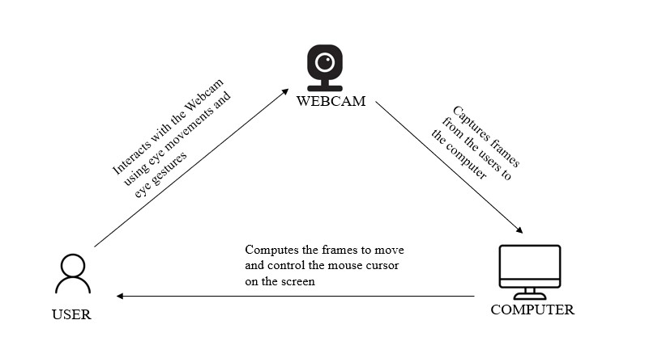
Architecture

Slide 11
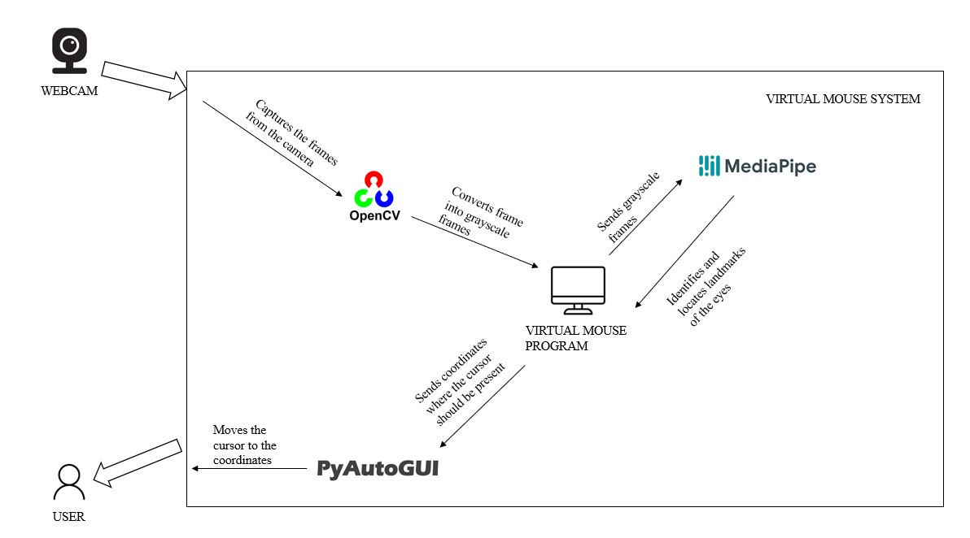
System Design – flow chart

Slide 12
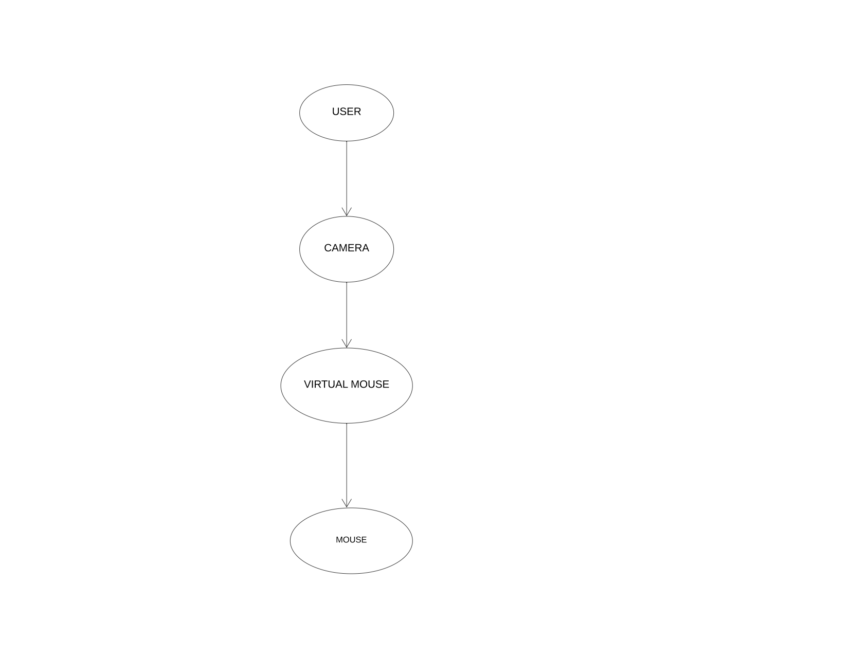
System Design - DFD

Slide 13
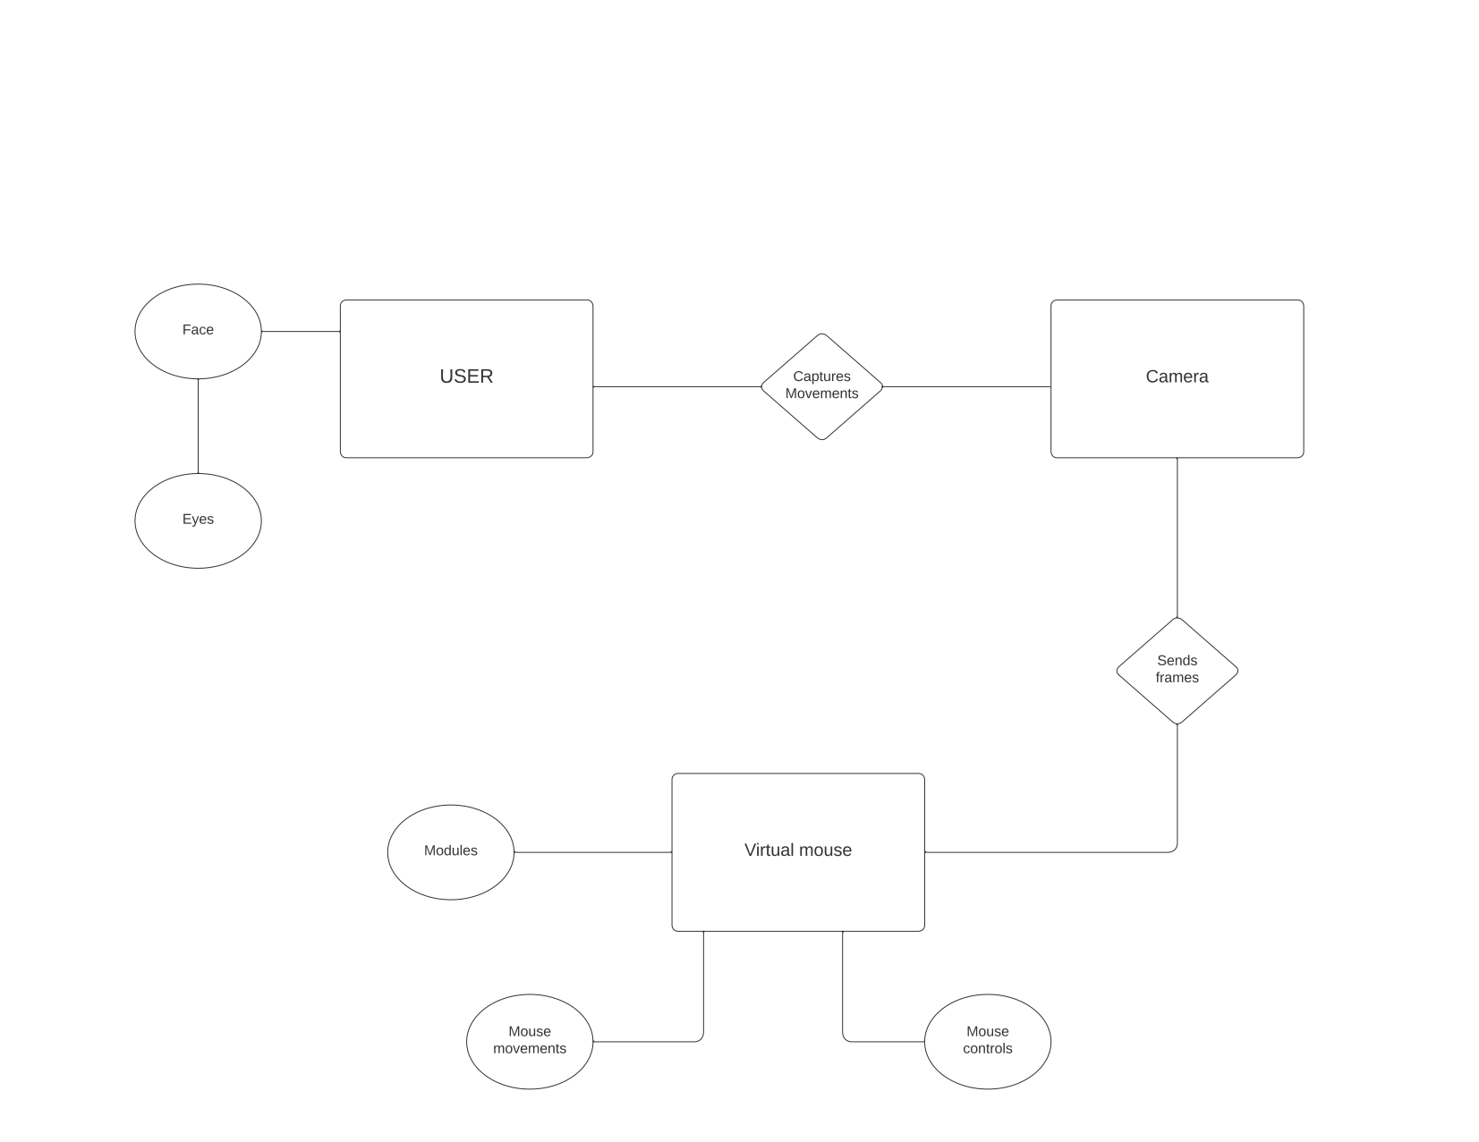
System Design - ER diagram

Slide 14
Module Description
MEDIAPIPE
MediaPipe is a comprehensive, cross-platform, and open-source framework developed by Google that enables developers to build complex multimedia processing pipelines.
It consists of a set of pre-built models and functions that can be customized to create real-time multimedia applications for desktop, mobile, and edge devices.
MediaPipe is designed to be easily integrated with other frameworks and libraries, such as OpenCV and OpenGL, and supports a variety of programming languages, including C++, Python, and Java.

Slide 15
Module Description
OpenCV
OpenCV (Open Source Computer Vision Library) is a widely used open-source computer vision and machine learning library, developed by Intel and now maintained by the OpenCV.org community.
It provides a comprehensive set of tools and functions for image and video processing, including object detection and tracking, face recognition, optical flow, stereo vision, and more.
OpenCV is written in C++, but also provides APIs for Python, Java, and other programming languages, making it accessible to a wide range of developers.

Slide 16
Module Description
PyAutoGUI
PyAutoGUI is an open-source cross-platform Python library used for automating keyboard and mouse functions.
It allows users to programmatically control the keyboard and mouse, as well as capture and manipulate screenshots.
PyAutoGUI is often used for tasks such as GUI automation, testing, and repetitive tasks that require a large amount of mouse and keyboard input.
PyAutoGUI works on various platforms, including Windows, macOS, and Linux.

Slide 17
Testing
TEST CASE ID | TESTCASE/ ACTION TO BE PERFORMED | EXPECTED RESULT | ACTUAL RESULT | PASS/ FAIL
1 | User eye constantly blinking | It should detect eye | Not Detected | FAIL
2 | User eye is dirty | It should detect eye | Detected | PASS
3 | User having shivering | It should detect eye | Detected | PASS
4 | User specs not detect | It should detect eye | Detected | PASS
5 | Eye not blink properly | It should do appropriate action | Action not performed | FAIL

Slide 18
Testing
6 | Noisy Background | It should detect eye | Detected | PASS
7 | User is 1m away from camera | It should detect eye | Detected | PASS
8 | User is not rightly perpendicular to the camera | It should detect eye | Detected | PASS
9 | Left eye blink | Left click should be performed | Left click performed | PASS
10 | Right eye blink | Right click should be performed | Right click | PASS
11 | Two face is seen | Should focus on one face | One face detected | PASS

Slide 19
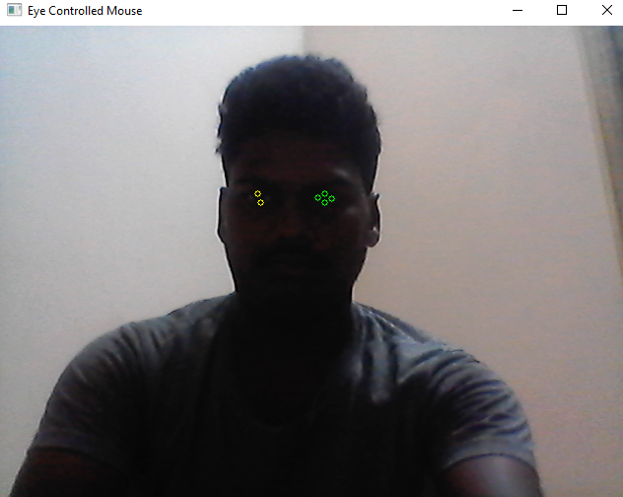
Screen Shots

Slide 20
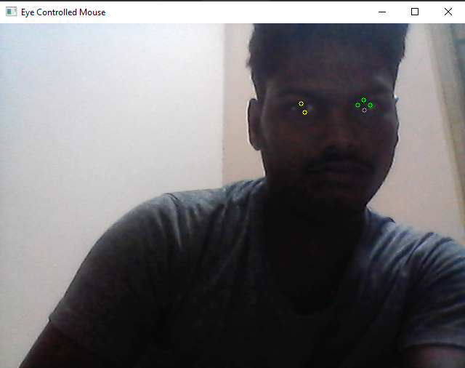
Screen Shots

Slide 21
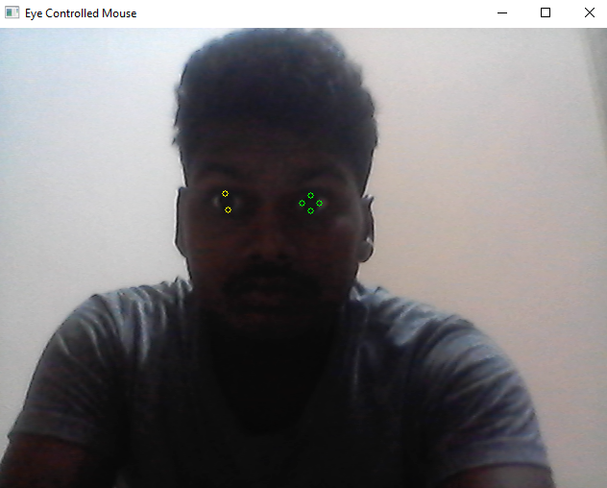
Screen Shots

Slide 22
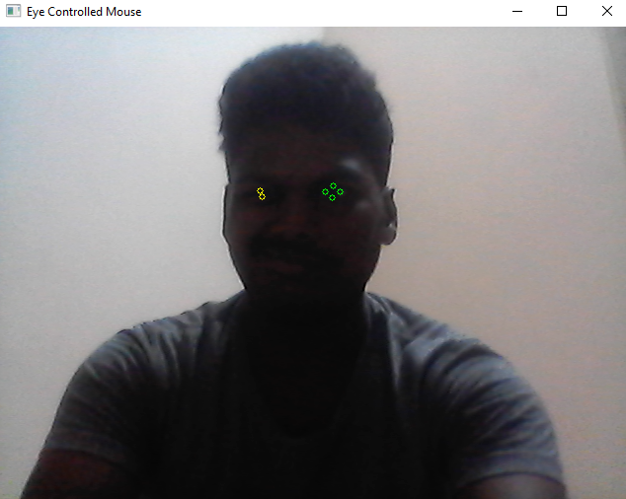
Screen Shots

Slide 23
Conclusion
We have implemented a virtual mouse system to access the mouse cursor on the computer screen using only face movements. With the use of a camera and python technology, the system architecture is achieved.
User is able to view eye movements and eye gestures captured through the camera which is displayed on the computer screen, accordingly the user can move the mouse cursor as needed and also perform various mouse actions.
The proposed system is feature based thus allowing any user to use the system without prior registration. This system is especially useful for the people with physical disability of the hand usage and in workplaces where physical touch is hazardous or cannot be used.
Thus, we implemented a basic upgradable model for a virtual mouse controlled using eye gestures.

Slide 24
Future Enhancement
We want to improve our system by adding timers for the usage of the system so that the user would be using the virtual mouse for a long period of time.
We would also like to integrate our virtual mouse with keyboard so that the computer usage would look like completely virtually.
The mouse can be improved by adding shortcut key such as volume control, brightness, windows, etc with new gestures.

Slide 25
Reference Paper/ URL
Nandini Modi and Jaiteg Singh "A comparative analysis of deep learning algorithms in eye gaze estimation" Published in: 2022 International Conference on Data Analytics for Business and Industry (ICDABI) View at: publisher site | IEEE.
Arqam M. Al-Nuimi and Ghassan J. Mohammed "Face Direction Estimation based on Mediapipe Landmarks" Published in: 2021 7th International Conference on Contemporary Information Technology and Mathematics (ICCITM) View at: publisher site | IEEE.
Victoria A. Sablina, Michael B. Nikiforov and Alexander V. Savin "Comparison of Facial Landmark Detection Methods for Micro-Expressions Analysis" Published in: 2021 10th Mediterranean Conference on Embedded Computing (MECO) View at: publisher site | IEEE.
Reyhan Seher Baştuğ, Bartu Yeşilkaya, Mazlum Unay and Aydın Akan "Virtual Mouse Control by Webcam for the Disabled" Published in: 2018 Medical Technologies National Congress (TIPTEKNO) View at: publisher site | IEEE.
Jhankar Mahbub CEO of Programming Hero View at: https://www.youtube.com/c/ProgrammingHero.

